Slide 1
JUGULAR VENOUS PRESSURE
DR.NAEEM QURESHI
GMC KOZHIKODE

Slide 2
Jugular venous pulse is defined as the oscillating top of vertical column of blood in the right Internal Jugular Vein (IJV) that reflects the pressure changes in the right atrium in cardiac cycle. In other words, Jugular venous pressure (JVP) is the vertical height of oscillating column of blood .

Slide 3
Jugular Venous System
Venous system contains 70-80% of the circulating blood volumes ,it maintain very low intravascular pressure ( 3-7mmhg)
Venous compliance therefore is very high , that is veins are extremely distensible
So jugular venous pulse reflects relationship between venous tone, volume of blood in venous system and right heart hemodynamics
Right atrial pressure during systole and right ventricular filling pressure during diastole are producing pulsations and pressure waves in jugular veins .

Slide 4
Anatomy
At the junction of right internal jugular and subclavian vein, there is a slight dialatation k/a jugular bulb , found in internal jugular triangle just above the clavicle in right supra clavicualr fossa b/w 2 heads of sternocleidomastoid muscle.
Venous pulsation is visible but not palpable
Right IJV is usually assessed both for waveform and estimation of CVP

Slide 5
Anatomic landmark

Slide 6
Right IJV Preferred :Why?
Direct continuation of SVC and right atrium
Anatomically they are closer to to the right atrium
IJV is less likely affected by extrinsic compression from other structures in neck
There are no or less numbers of valves in IJV than EJV
Less impact of vasoconstriction on IJV due to sympathetic activity than EJV .

Slide 8
Position of Patient
Patient should lie comfortably and trunk is inclined by 45 degree position
Elevate chin and slightly rotate head to the left
Inclination angle should be subtended between trunk and bed , while neck and trunk should be in same line
When neck muscles are relaxed ,shining the light tangentially over the skin and see pulsations
In patients with low jugular pressure , a lesser (<30‘) inclination is desirable
In patients with high jugular pressure ,a greater (60-90‘) inclination is required to obtain visible pulsations
Simultaneous palpation of the left carotid artery and or apical impulse aids in timing of the venous pulsations in cardiac cycle .

Slide 9
JUGULAR VENOUS PULSE
CAROTID PULSE
Superficial and lateral in neck
Better seen than felt
Has two peaks and two troughs
Digital compression abolishes venous pulse
Jvp falls during inspiration
Abd compression elevates jvp
Deeper and medial in neck
Better felt than seen
Has single upstroke only
Has no effects
Do not change with respiration
Has no effects on carotid pulse

Slide 10
JVP waveforms
Normal JVP reflects phasic pressure changes in RA during systole and RV during diastole
Two visible positive waves ( a and v) and two negative troughs ( x and y).
Two additional positive waves can be recorded . C wave interrupts x descent and h wave precedes the next a wave

Slide 11
Timing of venous waves
Timing may be assessed by 2 methods
In first left carotid pulse is carefully palpated simultaneously with visual inspection of right sided jugular vein
In second jugular venous pulse is analysed in concert with auscultation of the heart sound

Slide 12
Normal JVP
Notes:
Visual method relies on dominance of jugular wave , because RA contraction precedes Lv contraction the jugular a wave is will be seen as a flickering pulsation just before the carotid artery pulse is felt.
If present a wave is coincident with an S4 and is approximately simulataneous with S1 , X descents occurs during systole and will be seen as a negative transient occuring between S1and S2.v wave begins in late systole and peaks just after s2

Slide 14
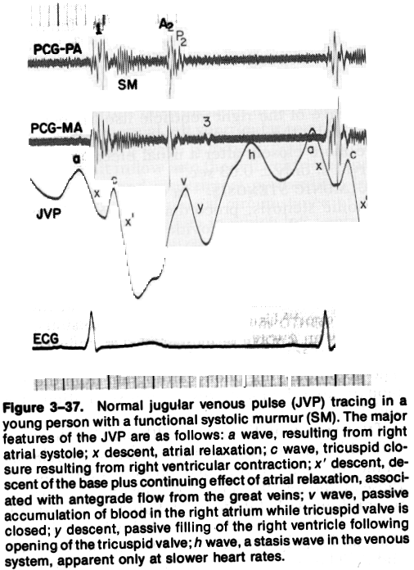
a Wave
First positive presystolic a wave is due to right atrial contraction results in retrograde blood flow in to svc and jugulars
Effective RA contraction is needed for visible a wave
Dominant wave in JVP and larger than v
It precedes upstroke of the carotid pulse and S1, but follow the P wave in ECG

Slide 15
x Descent
Systolic x descent (systolic collapse) is due to atrial relaxation during atrial diastole
X descent is most prominent motion of normal JVP which begins during systole and ends just before S2
It is larger than y descent
X descent more prominent during inspiration

Slide 16
c WAVE
Second positive wave recorded in JVP which interrupts the x descent
Produced by carotid artery impact on JVP and upward bulging of closed TV into RA during isovolumic contraction

Slide 17
x` Descent
x`descent is systolic trough after c wave .
Due to fall of right atrial pressure during early RV systole
Downward pulling of the TV by contracting right ventricle
Descent of RA floor by contracting RV

Slide 18
v Wave
Third positive wave in JVP which begins in late systole and ends in early diastole .
Rise in RA pressure due to continued RA filling during ventricular systole when tricuspid valve closed .
It is roughly synchronous with carotid upstroke and corresponds S2 .

Slide 19
y Descent
Diastolic collapse wave (down slope v wave)
It begins and ends during diastole well after S2
Decline of RA pressure due to RA emptying during early diastole when tricuspid valve opens
Initial y descent is corresponds to rapid RV filling and later part of y wave is produced by continued diastolic inflow in to RV .

Slide 20
h wave
Small brief positive wave following y descent just prior to a wave during period of diastasis
Described by Hieschfelder in 1907
It usually seen when diastole is long (as in slow heart rates)
With increasing heart rate, y descent immediately followed by next a wave .

Slide 21
Diffrentiating a and v wave
 | A wave | V wave
Mechanism | Atrial contraction | Passive filling of atrium
Timing | Presystole ( pre s1) | End systole ( s2)
Hieght | Tall | Less tall
Duration | Brief | Sustained
Morphology | Flicker | Blunted
Relation to ECG | P wave | T wave

Slide 22
Estimation of JVP ( traditional)
Two scale method is commonly used
A horizontal scale at the top of the oscillating venous column in IJV cuts the vertical scale at the sternal angle gives JV pressure in cm of water
Normally JV pressure does not exceed 3cm above the sternal angle
Since RA is approximately 5 cm below the sternal angle , the jugular venous pressure (RA mean pressure) is corresponds to 8cm
By way of conversion , normal mean JV pressure does not exceed 7 mm Hg (8 cm column of water / 1.3 =6.15)
Elevated JVP : JVP of >3 cm above sternal angle .

Slide 23
Estimation of JVP

Slide 24
Clavicle as refrence
The actual distance between the mid right atrium and angle of louis varies considerably as a function of both body size and patient angle at which the assesment is made.
Use of sternal angle as a refrence point leads to systemetic underestimation of CVP and this method should be used less for semiquantification than to distinguish between normal and abnormal
The use of clavicle may provide an easier refrence for standardisation , venous pulsation above this level in sitting position are clearly abnormal, as the distance between the clavicle and right atrium is atleast 10 cm.

Slide 26
Elevated JVP
Increased RVP and reduced compliance:
Pulmonary stenosis
Pulmonary hypertension
Right ventricular failure
RV infarction
RV inflow impedance:
Tricuspid stenosis / atresia
RA myxoma
Constrictive pericarditis

Slide 27
Elevated JVP
Circulatory overload :
Renal failure
Cirrhosis liver
Excessive fluid administration
SVC obstruction
COPD , Asthma and Respiratory distress may produce distended neck veins as a results of expiratory increases in intrathoracic pressure
HYPERKINETIC STATE like pregnancy, thyrotoxicosis , anemia , AV fistula post exertion , anxiety

Slide 29
Prominent a Wave
Forceful atrial contraction when there is resistance to RA emptying or increased resistance to ventricular filling,
RV inflow obstruction:
Tricuspid stenosis or atresia
RA mxyoma
Decreased ventricular compliance:
Pulmonary stenosis
Pulmonary hypertension of any cause
RV infarction
RV cardiomyopathy (including HOCM)
Acute pulmonary embolism

Slide 31
Cannon Waves
Whenever RA contracts against closed TV valve during RV systole : Systolic cannon wave .
Regular cannon waves:
Junctional rhythm
VT with 1:1 retrograde conduction
Isorhythmic AV dissociation
Irregular cannon waves :
Complete heart block
Classic AV dissociation
Ventricular pacing or ventricular ectopics .

Slide 33
Cannon wave

Slide 34
Absent a Wave
When no effective atrial contraction as in atrial fibrillation
In atrial fibrillation , both atrial contraction as well as relaxation become ineffective
In sinus tachycardia , when a wave may fuse with preceding v wave , especially when the PR interval is prolonged .

Slide 35
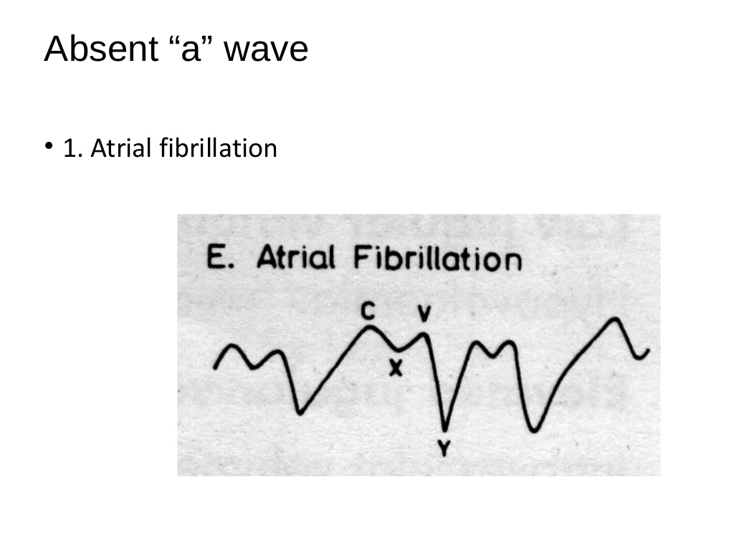

Slide 36
Prominent x descent
Cardiac tamponade.
Constrictive Pericarditis
RVMI
Restrictive Cardiomyopathy
Atrial septal defect
Blunted x descent
Tricuspid regurgitation.
Right atrial ischaemia

Slide 37
Absent x descent
Obliteration of x descent with early build up of large systolic wave ( cv wave)
Moderate to severe TR: EARLY SIGN
RV dysfunction due to
PHT with RV failure
severe RV infarction
Chronic atrial fibrrilation : loss of atrial relaxation

Slide 38
Prominent v wave
Increased RA volume during ventricular systole produce prominent v wave
Severe TR : giant v wave (Lanci sign) – ventricularization of atrial / jugular pressure
Giant v wave sometimes causes :
systolic movement of ear lobe
head bobbing with each systole
systolic pulsation of liver
pulsatile exophthalmos
pistol shots heard over IJV

Slide 39
Prominent V wave
Tricuspid regurgitation
ASD with mitral regurgitation
VSD of LV to RA shunt (Gerbode's defect)
Severe congestive heart failure
Cor pumonale

Slide 41
CV of TR

Slide 42
Prominent Y descents
Constrictive pericarditis
Tricuspid regurgitation
Atrial septal defects
Absent Y descent
Cardiac temponade
RV infarction
Slow y descent
Tricuspid stenosis
Right atrial myxoma

Slide 44
Abdominal -Jugular Reflux
Hepatojugular reflux – Rondot (1898)
Apply firm pressure over upper abdomen preferably to right upper quadrant , for atleast 10 sec with patient lying comfortably and breathing quietly while observe JVP
Normally JV pressure rises transiently(15 sec) to < 3cm while abdominal pressure is continued.
Positive response defined as rise of more than 3cm in venous pressure sustained for atleast 15 sec

Slide 45
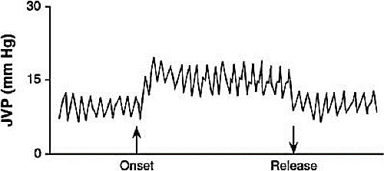
Positive AJR
Incipient and or compensated RVF
LVF with volume overload
Tricuspid regurgitation
False Positive AJR ( without CCF)
COPD
Systemic vasoconstriction
Increased sympathetic tone
Severe anaemia

Slide 46
AJR

Slide 47
Kussmual's sign
Mean jugular venous pressure increases during inspiration as a result of impaired RV compliance.
Constrictive pericarditis
Severe right heart failure
RV infarction
Restrictive cardiomyopathy

Slide 48
Pathophysiological Mechanism
KS explained by conditions which causes RV dysfuncytion, impaired RV filling and raised atrial pressure
The inability for cardiac chamber to expand due to :
1. hypoelasticity or inelasticity of the myocardium : infection and fibrosis ( RCMP)
2. mechanical compartmentalization by constrictive pericardial disease ( CCP )
3. impaired RV function resulting from RVMI impede effective RV filling and cause a paradoxical increase in JVP during inspiration ( RVMI )

Slide 49
Kussmauls sign

Slide 50
Cardiac temponade
JVP is usually elevated
a wave never prominent
v and x wave is normal
y descent is diminished or absent
Kussmaul's sign usually negative

Slide 51
Constrictive pericarditis
JVP is elevated
a wave is usually normal
v wave is usually equal to a wave
x descent –prominent
y descent – rapid descent
Kussmauls sign is usually positive

Slide 52
Constrictive Pericarditis

Slide 53
CP
Notes:
A man with constrictive pericarditis had elevated jugular venous pressure (JVP) to 20 cm H2O with prominent x and y descents. This JVP contour distinguishes constriction from other conditions that can present with dyspnea on exertion with jugular venous pulsations, like pulmonary hypertension (prominent a waves), tricuspid regurgitation (giant c to v wave), and restrictive cardiomyopathy (blunted x descent). He had a pericardial knock on cardiac auscultation and a right axis shift and inferolateral T-wave inversions on electrocardiography. Cardiac catheterization confirmed the diagnosis of constrictive pericarditis. See https://ja.ma/2ZaJwMM​

Slide 54
Endomyocardial fibrosis
JVP is usually elevated
a wave is prominent
v wave is prominent due to TR
x descent is obliterated due to TR
Rapid y descent is due to TR
Kussmaul's sign is negative

Slide 55
Primary Pulmonary Hypertension
Normal RV compliance :normal JVP
Early RV decompensation :
JVP may be elevated
a wave is prominent and larger than v wave
x and y descent seen and equal
Decompensated RVF:
JVP is always elevated
a and v wave prominent , v wave larger than a wave
x descent is diminished or absent
rapid y descent due to TR

Slide 56
JVP | DCMP | RCMP | EMF | CT | CCP
a wave | Normal | Prominent | Prominent | Never prominent | Normal , may be prominent
V wave | May be prominent | Normal | Promient due to TR | Normal | Usually equal to v wave
X descent | Normal | Normal | Obliterated with TR | Normal | Prominet
Y descent | May be rapid | Normal | Rapid due to TR | Decrease or absent | Rapid
Kussmaul”s sign | Negative | May be positive | Negative | Negative , may be positive | Usually positive

Slide 57
JVP | Cardiac temponade | CCP
JV PRESSURE | ELEVTED | ELEVATED
a wave | Never prominent | Normal , may be prominent
V wave | Normal | Usually equal to v wave
X descent | Normal | Prominent
Y descent | Decrese o r absent | Rapid
Kussmaul~s sign | Negative , may be positive | Usually positive

Slide 58
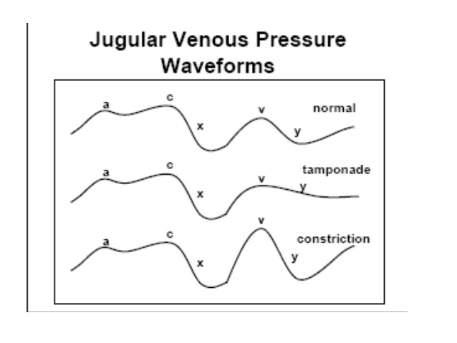

Slide 59
JVP in ASD
JVP is normal and equal a and v waves. x descent is more prominent .
Elevated JVP may seen in severe PAH and in RVF
Prominent a wave with PS and MS
Prominent v wave with PAH and in RVF with TR
Rapid y descent with RVF or TR

Slide 61
JVP in VSD
Prominent a wave with severe PS
Elevated JVP with CHF
Prominent v wave with Gerbode's shunt
In Eisenmenger complex :
JVPressure usually normal
Normal a and v waves
CHF and TR is rare

Slide 62
Ebstein Anomaly
JVP is usually normal
Prominent a waves are seen only occasionally
Attenuated x descent and systolic v wave are not reflected in jugular pulse despite appreciable TR
Unimpressive JVP is attributed to damping effect of large capacitance RA and thin, toneless atrialized RV (Hypokinetic TR)
Prominent a and v / elevated JVP with advent of right ventricular failure .

Slide 63
Cyanosis with normal JVP
It usually indicates cyanotic CHD with VSD and reduced PBF
Tetralogy of Fallot
TOF like physiology
VSD with right to left shunt
Pulmonary AV Fistula

Slide 64
Cyanosis with Elevated JVP
Elevated JVP in cyanotic CHD usually indicates intact IVS or increased PBF or both
Common in TGA or TAPVC with increased PBF
Severe PS with intact IVS and Right to Left shunt
Tricuspid atresia with restrictive ASD
Eisenmenger syndrome with ASD and PDA , JVP may be elevated
PPH with RVF and right to left shunt
Adult TOF

Slide 65
JVP in Eissenmenger syndrome
ASD with R to L shunt | VSD with R to L shunt | PDA with R to L shunt
JV pressure may be elevated | Usually normal | May be elevated
Normal a waves , but absent with AF | Normal a wave | Prominent a wave
Prominent v wave with CHF or TR | Normal v wave, CHF and TR rare | Prominent v wave with CHF and TR

Slide 66
What Is New?
The current standard assessment of acute decompensated heart failure patient volume status is inaccurate and may contribute to unnecessary readmission, which is profoundly costly.
In this work, we demonstrate the utility of point‐of‐care ultrasound measurement of right internal jugular vein compliance as a noninvasive, objective, rapid, and portable technique for predicting freedom from hospital readmission at 30 days.
Published in JAHA in 24 july 2018

Slide 67
USG guided estimation of JVP
Patients admitted with acute decompensated heart failure (ADHF) underwent ultrasound measurements of the right internal jugular vein at end‐expiration and during the strain phase of Valsalva to determine a percentage of CSA change
This bedside ultrasound technique strongly correlates to invasive RAP measurement in ADHF patients, identifies restoration of euvolemia, and is predictive of 30‐day ADHF readmission. This tool could help guide inpatient ADHF treatment and may lead to reduced readmissions.
Published in JAHA in 24 july 2018

Slide 68
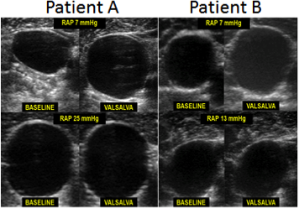
What Are the Clinical Implications?
Heart failure patients admitted with acute decompensated heart failure could undergo an objective noninvasive assessment of volume status, which has the potential to guide diuretic therapy and discharge planning.

Slide 69
Refrences
Jonathan Abraham
Braunwald
Nejm
JAHA

